Slide 1
Grade 3 - ICT360
Page Design
Creating Comic Books with MS Word
Storybooks
Comics
MS Word

Slide 2
What We Will Learn Today
1
Types of Books
2
Comic Book Elements
Storybooks and Comic Books
Characters, Dialogues & Background
3
MS Word Insert Tab
4
Creating Our Comic Strip
Pictures, Shapes & WordArt
Step-by-Step Guide
5
Practice Exercise
Test Your Knowledge!
Let's have fun learning about page design!

Slide 3
Let's Explore Books!
Look at Your Textbook!
Why Are These Important?
What do you see when you open your textbook? Look closely and list all the elements you can find!
These elements make reading fun and help you understand stories better!
Elements you'll find:
Pictures grab your attention
Pictures of characters
Dialogues
Dialogues make stories come alive
Headings and titles
Page numbers
Headings help you find topics
Author's name
Did you know? Apart from textbooks, there are many different types of books like storybooks, comic books, and more!

Slide 4
Storybooks vs Comic Books
Storybooks
Comic Books
What they contain:
What they contain:
A story or collection of stories
Collection of individual scenes called comic strips
Who reads them:
What's inside:
Usually meant for children
Characters, images, and dialogues to tell a story
Characters:
Series:
One or more characters. The main character is called the LEAD
Many books about one lead character - called periodicals
Example: Fairy tales, adventure stories
Example: Superhero comics, manga
Key Difference: Storybooks use mostly text, while comic books use pictures and speech bubbles!

Slide 5
The 3 Parts of a Comic Book
Every comic strip has these three important elements!
Characters
Dialogues
Background
A character is part of the story shown through images. Each character has different dialogues.
A dialogue is the conversation between two or more characters. It makes the story exciting!
Background makes the comic strip colorful and shows scenes related to the dialogue.
Can be:
Shown in:
Adds:
• A person
Speech bubbles!
• Colors
• An animal
• Scenes (park, home, etc.)
• A thing
• Setting for the story
Comics can have multiple characters!
Characters talk to each other!
Makes comics beautiful!
We can create comics in MS Word using the Insert tab! Let's learn how!

Slide 6
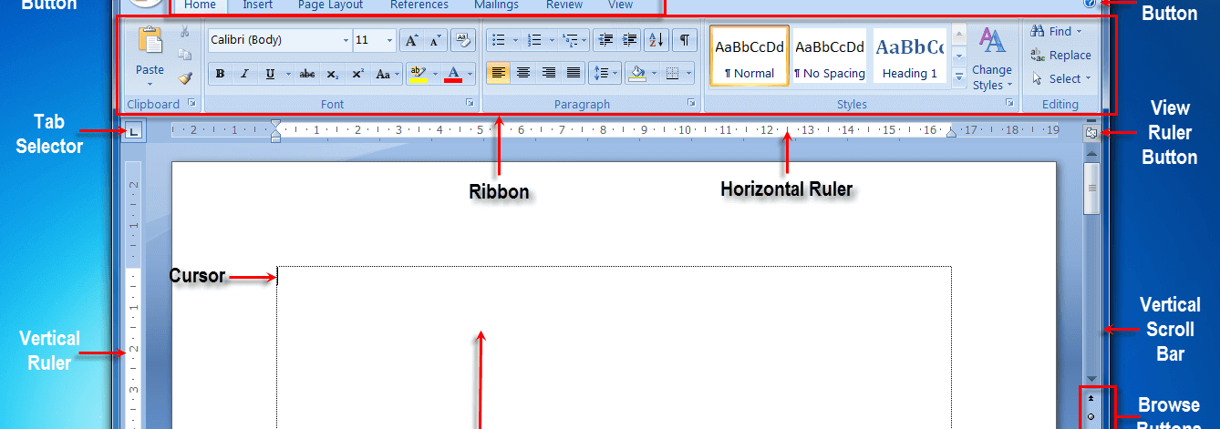
Meet the Insert Tab in MS Word
Where to Find It
What Can You Insert?
The Insert tab is located at the top left corner of MS Word. Click on it to see all the tools!
Tables
Organize information
Pictures
Add images and clip art
Shapes
Rectangles, circles, arrows
Charts
Show data visually
Click "Insert" to open the magic toolbox!
WordArt
Make text look fancy
Header & Footer
Top and bottom margins
Remember: We use the Insert tab to add pictures, text, and background to create our comic!

Slide 7
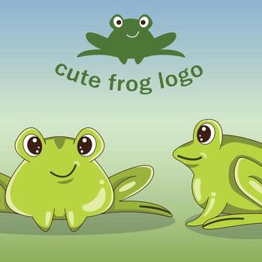
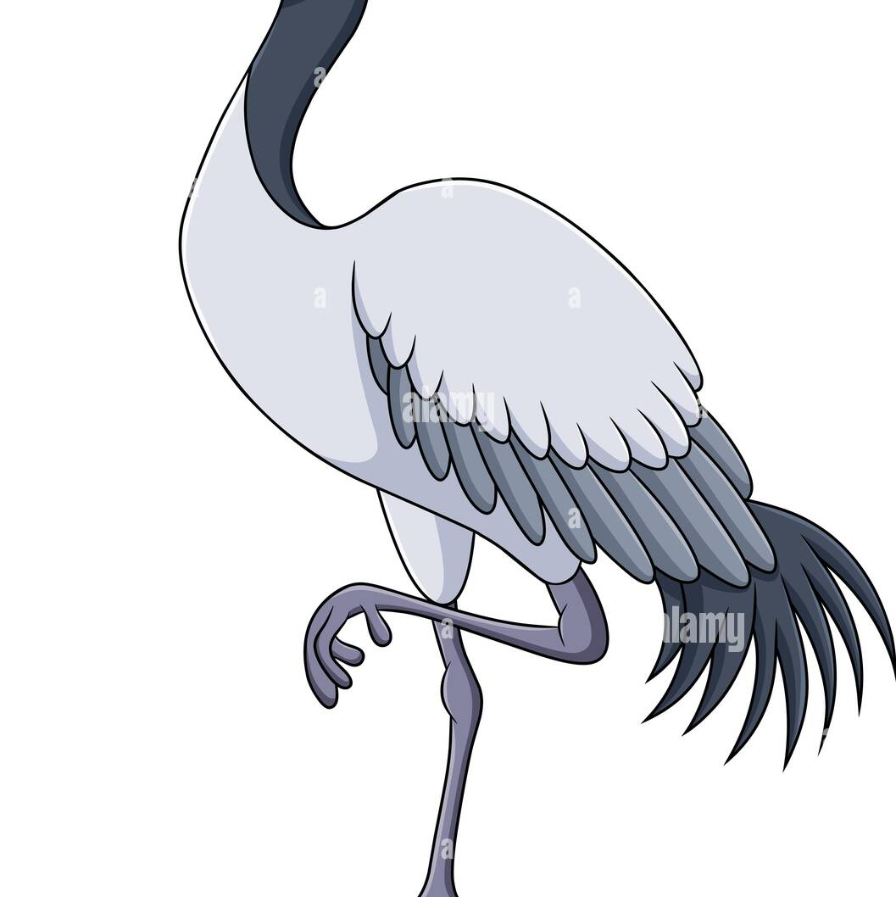
Our Story
Best Friends
Makdoo the frog and Saloni the crane
The Story Dialogues
1
Saloni:
"Makdoo, I am leaving! I will be back in a few months."
Makdoo
2
Makdoo:
The Frog
"Where are you going Saloni? Why don't you stay here with me?"
Lives in the pond
3
Saloni:
"I am going south for the Winter. It is very cold here and I cannot find any food."
4
Makdoo:
"Come back soon! I will miss you."
5
Saloni:
"Yes, I will tell you all about my trip when I am back."
Saloni
The Crane
6
Makdoo:
"Bye"
Can fly away
Now let's create this comic strip in MS Word step by step!

Slide 8
Steps 1-3: Setting Up Your Comic
1
Open MS Word
2
Add Header
3
Apply WordArt
Start by opening Microsoft Word on your computer.
A header is the top margin of the page. We'll add our comic title here!
WordArt makes your heading look fancy and colorful!
How to open:
Steps:
Steps:
•
Click the Start menu
a
Click Insert menu
a
Select WordArt from Insert tab
•
Find Microsoft Word
b
Select Header
b
Choose any effect you like
•
Click to open!
c
Choose Blank
c
Move heading to center
d
Type: "BEST FRIEND"
d
Double-click to apply
Ready to create!
Header added!
Looking great!
Tip: Headers and footers are used for information you want to repeat on multiple pages!

Slide 9
Steps 4-6: Background & Characters
4
Create Background
5
Add Characters
6
Speech Bubbles
Use shapes to create a colorful background for your comic!
Insert pictures of your characters in front of the background!
Add speech bubbles to show what characters are saying!
Using Shapes:
Insert Pictures:
Using Callouts:
MS Word has basic shapes, lines, curves, arrows, and speech bubbles!
a
Go to Insert → Pictures
a
Select Callout from Shapes
b
Search for clip art online
b
Click a speech bubble
a
Click Shapes in Insert tab
c
Use keywords: "crane bird clip art"
c
Drag it inside background
b
Select Rectangle
d
Or "frog clip art"
d
Type the dialogue
c
Drag to draw & resize
e
Format the text (size, color)
Clip Art: Simple pictures available online to add to documents
Background ready!
Characters added!
Dialogues added!
Healthy Practice: Use Creative Commons images (free to use!)
Tip: Use "In Front of Text" to place images over background

Slide 10
Steps 7-10: Finishing Your Comic
7
Spell Check
9
Create More Panels
Check your spelling to make sure everything is correct!
Use copy-paste to create more comic panels quickly!
How it works:
Shortcut Magic:
• Red line = spelling mistake
• Select elements with Shift key
• Right-click the word
• Ctrl+C to copy
• Choose the correct spelling
• Ctrl+V to paste
• Rotate speech bubbles
8
Add Colors
10
Add Footer
Make your comic colorful with Shape Fill!
Add your name and date at the bottom!
Steps:
• Double-click the background
Steps:
• Select Shape Fill
• Click Insert → Footer
• Choose a color you like!
• Add your name
• Add the date
• Double-click to apply
Congratulations! Your comic strip is now complete! You can create storybooks too!

Slide 11
Practice Time!
Let's Practice!
Multiple Choice
Fill in the Blanks
1. What is a header and footer?
4. _______________ is used to apply borders to shapes.
a. Top and bottom margin ✓
Answer: Shape Format
b. Bottom and top margin
c. Top and middle margin
5. _______________ option is used to align a picture with text.
2. Which option lets you select a rectangle shape?
Answer: Wrap Text
a. Pictures
b. WordArt
c. Shapes ✓
6. Change the color of shapes with shape _______________.
Answer: Fill
3. Which option adds speech bubbles?
a. Rectangles
b. Basic shapes
Tech Flash
c. Callouts ✓
Header: Top margin of the page
Footer: Bottom margin of the page
Shapes: Prebuilt visual elements
Shape Format: Apply effects to shapes
Great job! You've learned so much!

Slide 12
Great Job!
What We Learned Today
Types of Books
Comic Elements
MS Word Skills
Storybooks & Comic Books
Characters, Dialogues, Background
Insert Tab & Creating Comics
Now that you know how to create a comic book, why don't you try to create a storybook?
That is a great idea!
I will try! 🎨
Keep Creating!
Keep Learning!

